Slide 1
NUMERICAL INTIGRATION
NAZMUL KADER CHOWDHURY

Slide 2
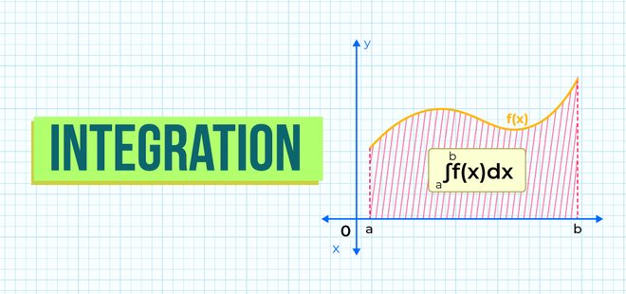
BASIC IDEA OF INTIGRATION
THE FUNCTION
THE AXIS
LOWER LIMIT
UPPER LIMIT

Slide 3
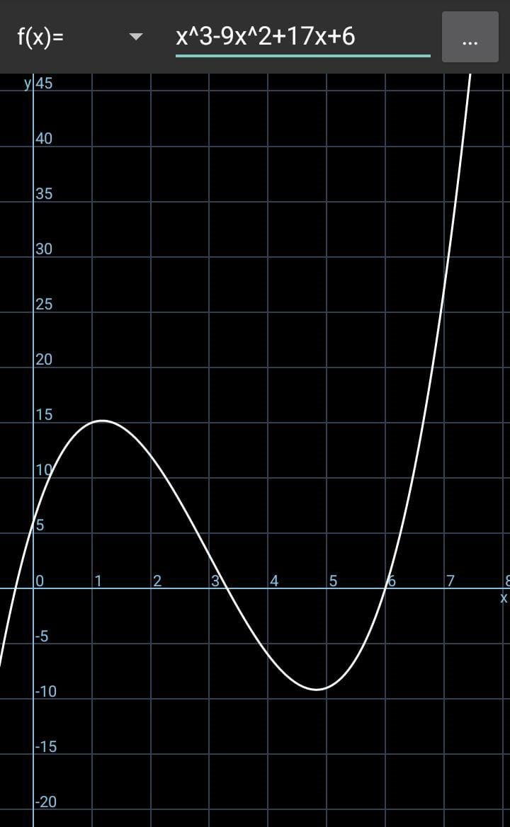
example

Slide 4
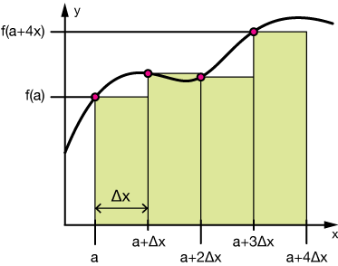

Slide 5
NUMERICAL INTIGRATION

Slide 6
TRAPIZOIDAL RULE

